Slide 1
miniTAO Workshop Observations of Massive Star Forming Regions at 30 microns
Mizuho Uchiyama
(Institute of Astronomy, Univ. of Tokyo)
T. Miyata, S. Sako, T. Kamizuka, K. Asano, K. Okada (IoA, Univ. of Tokyo),
T. Nakamura (Univ. of Tokyo), T. Yamashita,
T. Fujiyoshi (NAOJ), and TAO Group Members

Slide 2
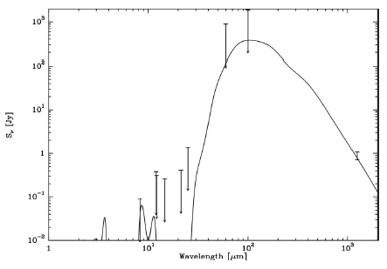
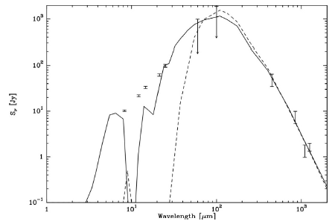
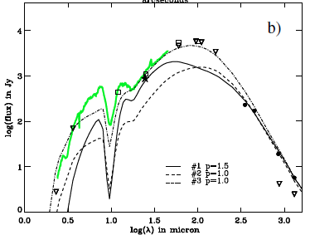
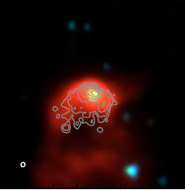
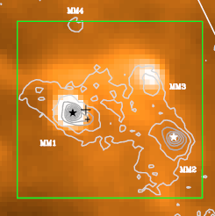
Outline of massive star formation
Zero Age Main Sequence
(ZAMS)
Ultra Compact
HII region
(UCHII)
Massive Young
Stellar Object
(MYSO)
Star-less Molecular Core
log(Sν) [Jy]
MIR
FIR
Submm
MIR
FIR
Submm
MIR
FIR
Submm
IRAC 3.6,4.5,8.0μm(color)
6cm(contour)
3’ (~3pc)
No free- free emission
Free- free emission
log(wavelength ) [μm]
Collapsing and internally heating
1’
Urquhart+2009
1
10
100
1000
1
10
100
1000
1
10
100
1000
Hydrogen burning begins and HII region is made and expanded.
MSX 8μm(color)
1.2mm(contour)
Marseille+2008
de Wit+2009
Marseille+2008
Notes:
大質量星の進化段階の図

Slide 3
Difficulties of Massive star formation
High accretion rate
High accretion rate is needed for overcoming radiation pressure feedback.
Fragmentation
M_{J} ∝ T^{3/2}ρ_{o}^{-1/2}
Typical molecular cores have small Jeans mass
Molecular Core
Low-mass
Object
~0.1 pc
Low density and/or warm gas is required for massive star formation.

Slide 4
Possibility of fragment suppressing mechanism
Suppressing Source
Supernovae shock
Turbulence
Magnetic field
Previously formed YSOs
Previously formed objects heat up the core by accretion luminosity feedback.
Observational data of temperature and luminosity in the molecular core is needed for checking this scenario.
Jeans mass
Heating
YSOs
Cold
Warm
Recent theoretical model (Krumholz & Tan 2008) predict this effect.
Notes:
温めるためにはどうするか？

Slide 5
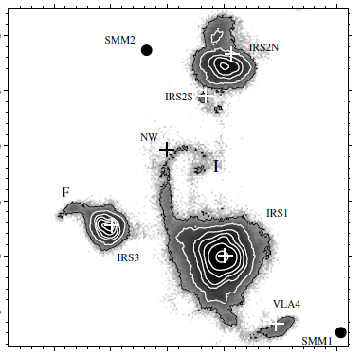
Massive star forming molecular core
Massive star forming molecular cores are very crowded and consist of various objects at different evolutional stages.
→ High resolution is needed!
25”
24.5μm image of S140 region observed by Subaru/COMICS (de Wit +2009)
To derive the temperature and the luminosity,
highly resolved observation at MIR is essential.
MIR
MYSO
1
10
100
1000
Notes:
実際はこんな風にごちゃごちゃ写る

Slide 6
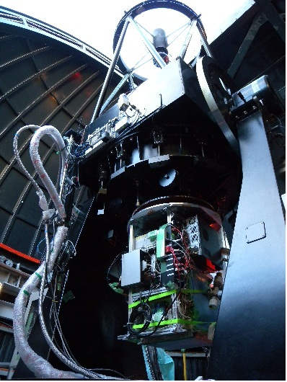
miniTAO / MAX38
Telescope’s aperture | 1.0m
Telescope’s site | Co. Chajnantor, Atacama, Chile
Altitude | 5,640m
Observable wavelengths | 8-38 micron
Spatial resolution | ~ 8” at 30 micron
miniTAO telescope
MAX38
miniTAO/MAX38 is the first and the only instrument that can observe up to 38 micron from the ground.

Slide 7
Observation targets
For evaluating the accretion luminosity feedback scenario
Nearby massive star forming cores
There are at least 2 bright MIR objects in compact (~ 0.1 pc) regions.
3 massive star forming cores have been observed.
M8E, RAFGL 6366S, IRAS 18317-0513
Object name | Distance | Observing band
M8E | 1.5 kpc | 18,25,30,37 micron
RAFGL 6366S | 2.0 kpc | 8.9,12,18,25,30 ,37micron
IRAS 18317-0513 | 3.2 kpc | 12,18,30 micron
0.1 pc separation is equal to ~ 10 arcsec at 2.0 kpc

Slide 8
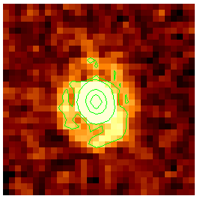
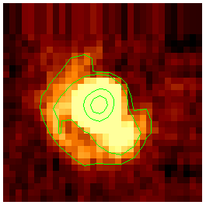
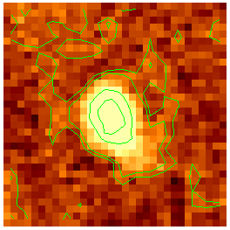
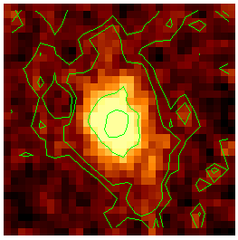
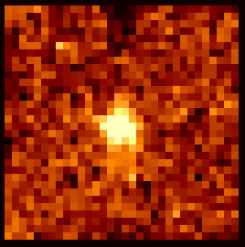
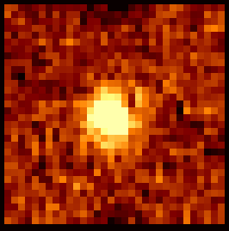
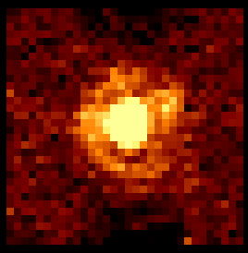
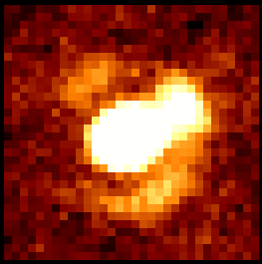
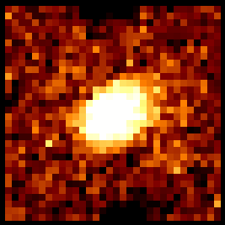
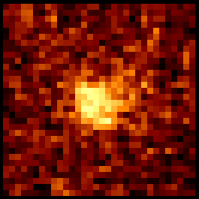
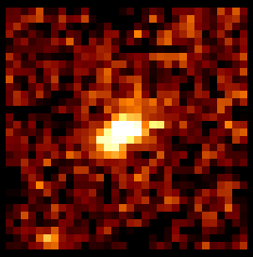
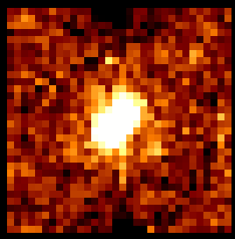
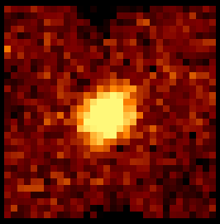
Observation results
MYSO
UCHII
M8E
Simon+
1984
0.3pc
40”
18μm
25μm
30μm
37μm
RAFGL 6366S
Rodon
2009
8.9μm
12μm
18μm
25μm
30μm
37μm
40”
0.4pc
IRAS 18317-0513
RMS
Survey
40”
0.6pc
12μm
18μm
30μm
Notes:
図の一覧

Slide 9
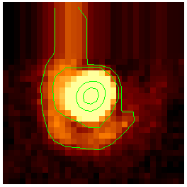
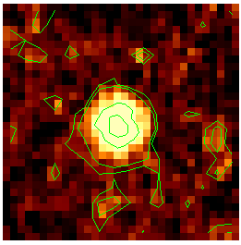
Detail structure of M8E
PSF reference
IRC+10420
M8E
[arcsec]
20 -
10 -
0 -
-10 -
-20 -
20 -
10 -
0 -
-10 -
-20 -
2 objects are clearly seen.
25μm
Diffraction pattern is overlapped with each object.
Each object’s flux count is measured by PSF profile fitting.
| | | | |
20 10 0 -10 -20
| | | | |
20 10 0 -10 -20
20 -
10 -
0 -
-10 -
-20 -
20 -
10 -
0 -
-10 -
-20 -
30μm
| | | | |
20 10 0 -10 -20
| | | | |
20 10 0 -10 -20

Slide 10
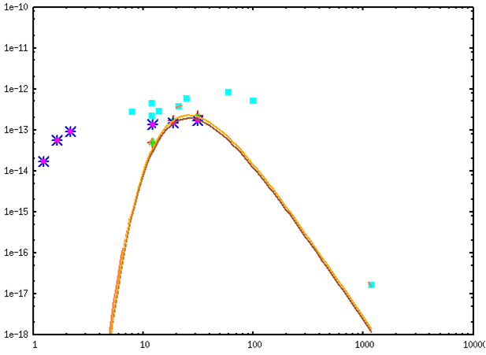
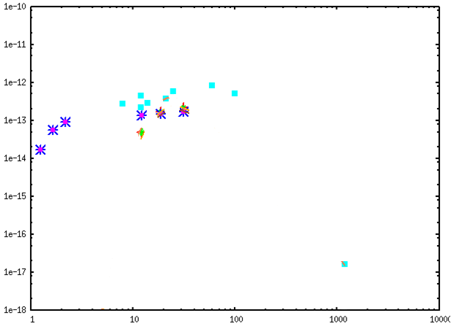
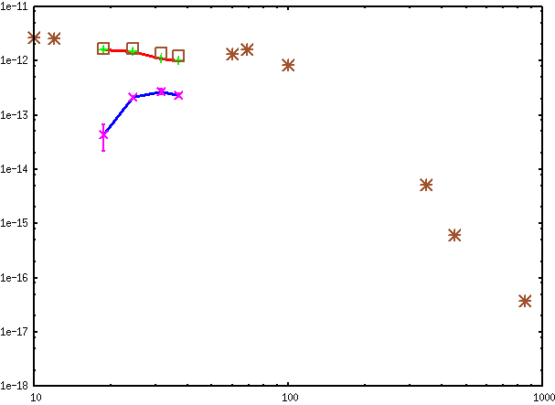
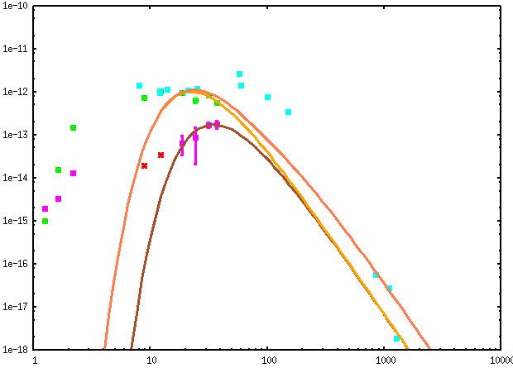
Result of photometry
Flux density [w/m²/um]
* Unresolved IRAS 18317-0513
- ・MYSO 1
- ・MYSO 2
10⁻¹¹
MYSO
* Unresolved M8E
- ・ MYSO
- ・ UCHII
*
*
*
*
*
10⁻¹²
*
*
*
10⁻¹³
UCHII
10⁻¹⁴
10⁻¹⁵
MYSO 1: ~3*10³L⊙
MYSO 2: ~3*10³L⊙
*
10⁻¹⁶
MYSO: ~7*10³L⊙
UCHII: ~1*10³L⊙
10⁻¹⁷
* Unresolved RAFGL 6366S
- ・MYSO
- ・UCHII
Wavelengh[μm]
*
*
*
*
*
10
20
30
50
100
500
1000
*
*
*
NIR data is connected to MIR data.
MIR and longer wavelengths are Black Body fitted.
→ Integrated & derived luminosity.
MYSO: ~5*10³L⊙
UCHII: ~1*10³L⊙
*
*
*
Notes:
SEDの一覧

Slide 11
Mass estimation
Estimating stellar mass assuming at near ZAMS
Observed core | Component | Mass
M8E | UCHII | 6M⊙
 | MYSO | >12M⊙
RAFGL 6366S | UCHII | 6M⊙
 | MYSO | >10M⊙
IRAS 18317-0513 | MYSO | >8M⊙
 | MYSO | >8M⊙
MYSO
UCHII
More Massive!!
MYSOs are heavier than UCHII!!

Slide 12
How is there when MYSO began to accrete?
Less massive objects evolve slower.
When MYSO began to accrete, less massive object already exits.
The less massive objects began to be formed earlier.
When A began to accrete (~0.1 Myr ago)
Observed
B
B
A
A
MYSO phase
UCHII phase
MYSO phase

Slide 13
Accretion luminosity feedback
With the accretion luminosity feedback scenario, less massive objects are formed earlier in molecular cores.
→Our study gives the first observational support to this scenario.
Jeans length
Heating
YSOs
Cold
Warm

Slide 14
Summary
3 massive star forming cores were resolved at 30 microns for the first time.
Luminosity and mass of each object are derived.
Observations suggest the less massive objects began to be formed earlier.
Our study gives the first observational support to the accretion luminosity feedback scenario.
In near future, ~5 more cores will be observed with miniTAO/MAX38.

Slide 16
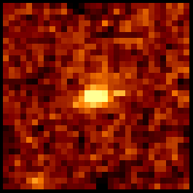
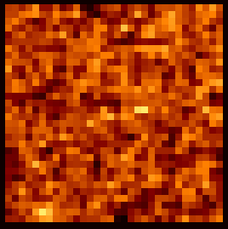
Photometry for each object
Χ² fitting was carried out for each image to separate two objects’ flux counts using PSF reference profile.
There are few MIR-standard stars that can be observed with MAX38.
Flux calibration was done by ISO-SWS’s data.
M8E was calibrated by its own data.
The others were calibrated by PSF reference star’s data.
fitting
object1
object2
PSF

Slide 17
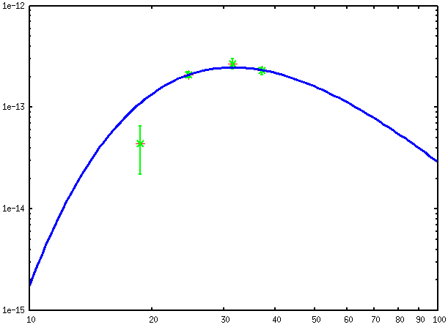
Calculating luminosity and mass
10⁻¹²
Observing band
Numerical
integration
Above them
B.B. fitting
and integrating
Calculating mass assuming each object is at ZAMS.
M8E
10⁻¹³
Flux density W/m²/μm
Black Body fitting
10⁻¹⁴
Numerical integration
Wavelength μm
波長[μm]
10⁻¹⁵
10
20
30
40
50
100

Slide 18
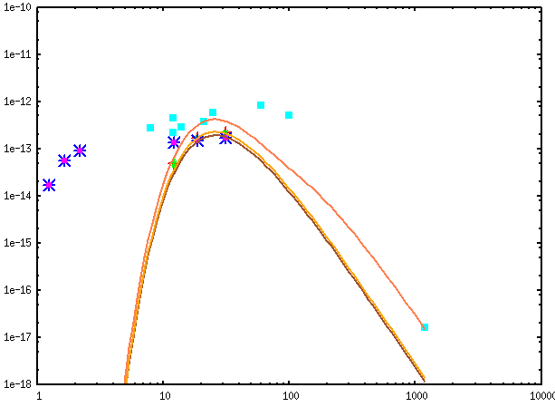
SED & luminosity calculation 1
Flux energy distribution
[w/m²/um]
Sum
Bright
Faint
IRAS 18317
Luminosity calculation
<30um
Numerical integration
≧30um
Faint: B.B. fitting using 12,18,30um (best fit 112K)
Bright: B.B. fitting using 18,30um (T as 112K)
Cooler component: B.B. fitting using sbmm (T as 30K)
Wave length [um]
Bright: 2.9*10³L⊙ Faint: 2.9*10³L⊙ Cool: 5.9*10²L⊙

Slide 19
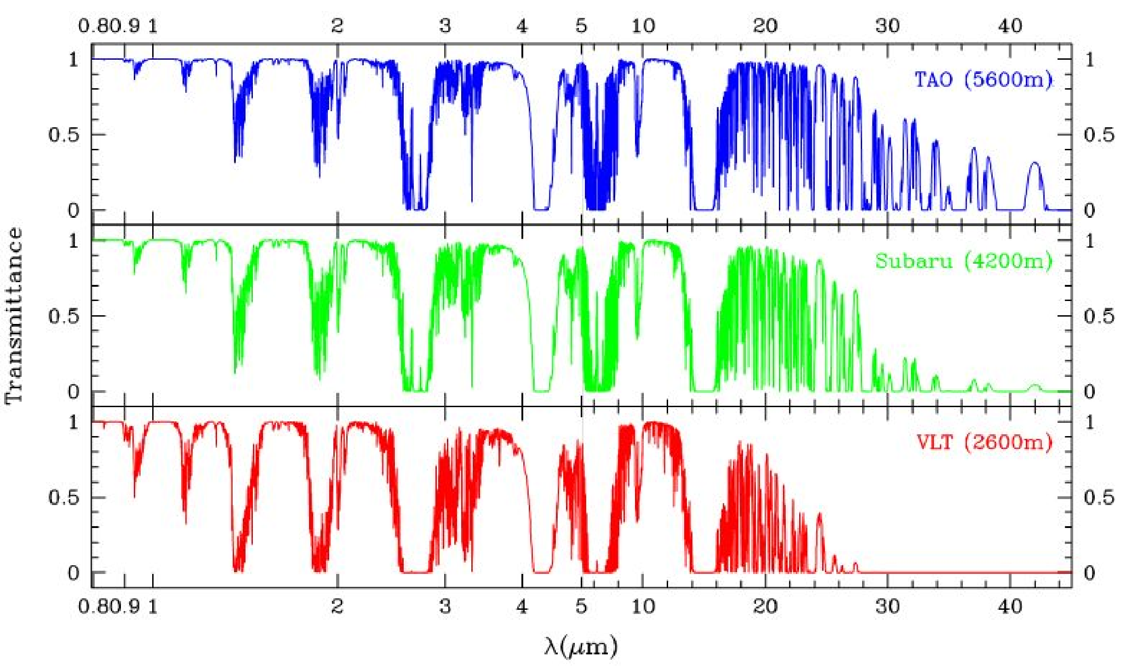

Slide 20
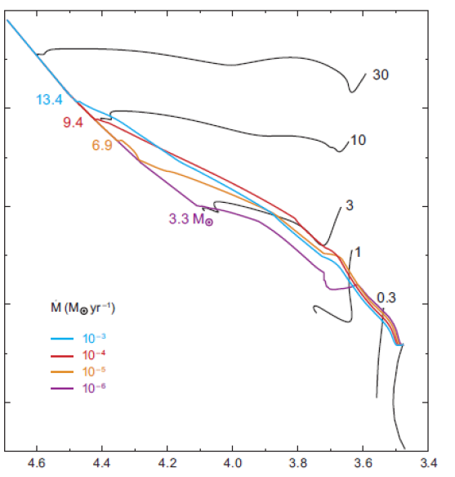
10⁶
10⁴
10M⊙
10²
・
M[M⊙/yr]
10⁻³
10⁻⁴
10⁻⁵
10⁻⁶
10
光度[L⊙]
4.6
4.4
4.2
4.0
3.8
3.6
3.4
Log T_{eff} [K]
Zinnecker &Yorke 2007

Slide 21
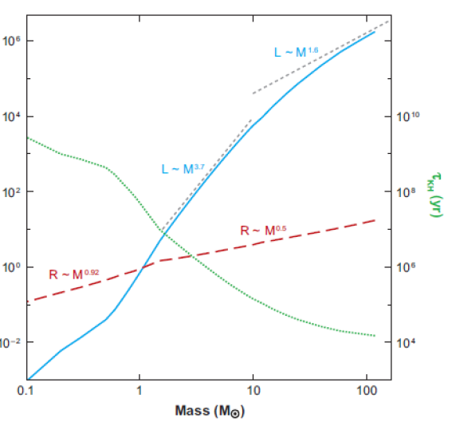
Kelvin–
Helmholtz
timescale
[yr]
1Myr
0.1Myr
0.01Myr
1
10
Stellar mass[M⊙]
(Zinnecker &Yorke 2007)

Slide 22
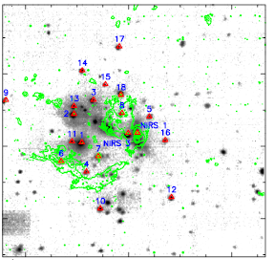
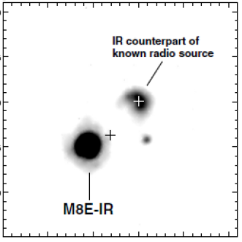
Discussion
0.4pc
Some star formation clusters are
found to form sequentially, from
low-mass stars to high mass stars.
(i.e. S255IR (Wang+2011))
This work shows that such sequential star formations can occur in molecular cores scale regions.
What made this in such a
small (~0.1pc) regions?
~1Myr
S255IR(Wang+2011)
0.05pc
This work
~0.3Myr
M8E

Slide 23
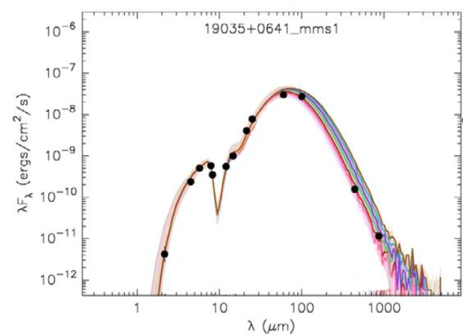
What happens in massive star forming molecular cores?
Physical information of each object in massive star forming core (~0.1pc) is needed.
Accurate luminosity and mass
are determined by measuring
the peek flux (~100K) of MYSO.
We are carrying out observations of massive star forming regions from ground at long-MIR (>20 micron).

