Slide 1
Observations of Bipolar planetary nebulae at 30 Micron
Kentaro Asano (Univ.Tokyo)
Takashi Miyata, Shigeyuki Sako, Takafumi Kamizuka, Tomohiko Nakamura, Mizuho Uchiyama,
Masahiro Konishi, Shintaro Koshida (Univ.Tokyo)
Notes:
Good morning.
My name is kentaro asano from the institute of astronomy, the University of Tokyo.
This is my first presantation in English.
Today, I will talk about our observational study titled “a New Detection of the Cold Dust Component in the Bipolar Planetary Nebula Mz three with miniTAO/MAX thirty eight thirty one micron image”.
Coauthor names are a bottom of this page.
Let’s begin to talk.

Slide 2
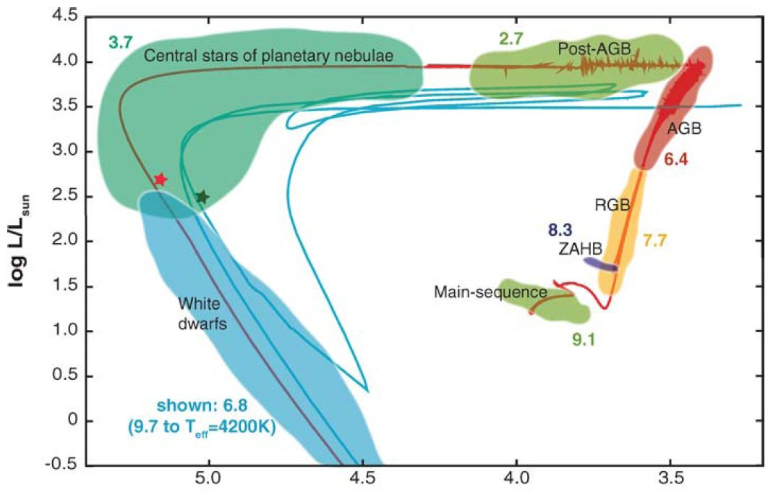
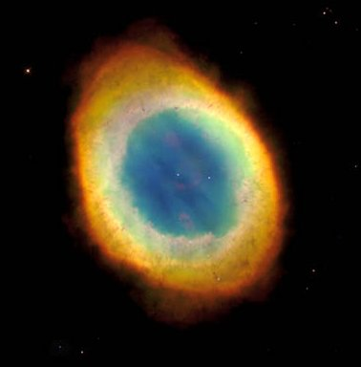
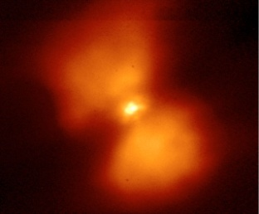
Introduction
What is the origin of dust in our galaxy?
→ AGB stars are one of the important sources of interstellar dust.
PNe are the final stage of stellar evolution.
PNe record the mass-loss history in the AGB phase.
It is important to observe the dust around planetary nebulae.
PNe
AGB
PNe
AGB
Notes:
The motivation of our study is to solve this question what is the origin of dust in our galaxy?
There are many dust suppliers in the galaxy, including supernovae, YSO, AGB stars, and so on.
Today I focus on the dust supply from the AGB stars.
AGB are late stage of low and intermediate mass stars.
This figure shows an evolutional track of the low and intermediate mass stars in the HR diagram.
These stars lose most of their masses around the AGB phase (here).
So the AGB stars are one of the important sources of the interstellar dust.
PNe are objects in the later stage of the AGB stars.
They record the mass-loss history from AGB to PN.
So, it is important to observe the dust around planetary nebulae.

Slide 3
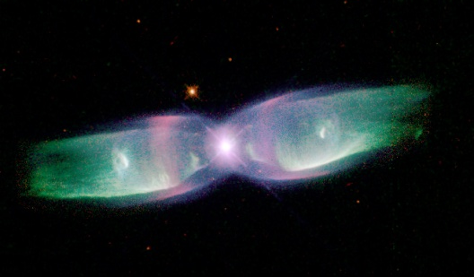
Dust souces of bipolar PNe
Massive AGB creates a mount of dust.
Initial mass :
1~4M☉ → round, elliptical PN
4~8M☉ → bipolar PN
Bipolar PNe are important dust sources.
→ Where is the dust in massive AGB phase?
The spatial distribution of dust in the bipolar PN
have not been well understood so far.
round
bipolar
Notes:
It seems a massive AGB star creates a large amount of dust.
Initial masses of PNe are from one to eight solar mass.
Recently, it is said that there is the relation between the initial mass and morphology in PNe.
PNe with the initial masses of one to four solar mass show round and elliptical shapes.
A bipolar PN is evolved from stars with the initial masses of four to eight.
This bipolar PN is called a massive PN.
It seems a massive PN creates a large amount of dust.
Where is the dust in bipolar PN?
So far, dust distributions in the bipolar PNe have not been well understood.

Slide 4
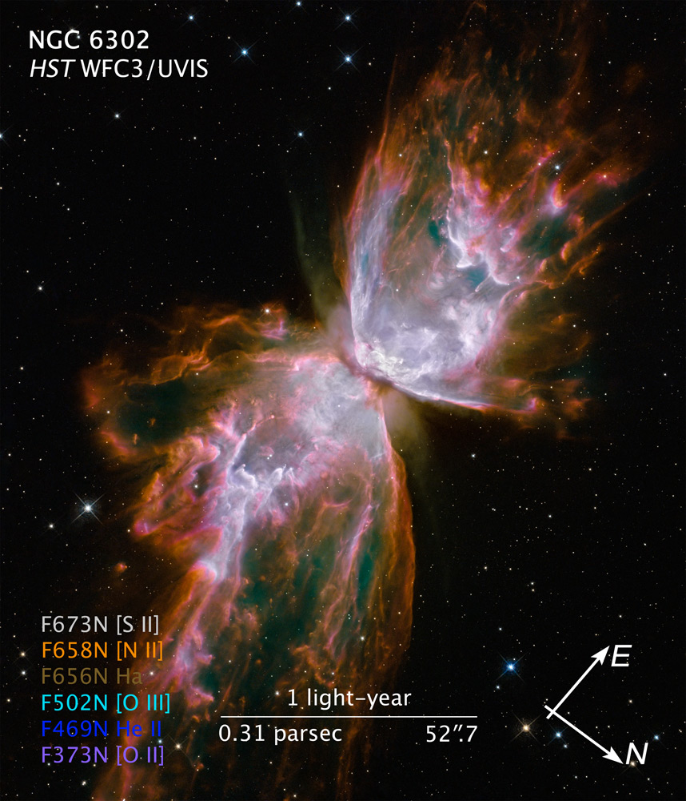
Massive torus in the bipolar PN
NGC 6302 is one of the most studied
bipolar PNe (e.g. Matsuura+ 2005)
Initial mass : 5M☉
A dark lane (a dust torus) can be seen
in the central region.
→ Massive dust torus : M_{dust}=3.0x10⁻²M☉
All bipolar PNe have
dust torus?
Notes:
Here shows an example of the bipolar PN.
This image is the most famous bipolar PN : NGC six three zero two.
This image was obtained by the Hubble Space Telescope.
It is one of the most studied bipolar PNe.
In this image, * you can see a dark lane clearly at the center of the nebula.
This indicates that there is a massive dust torus around the central star.
*The mass of this dust torus is estimated to be three point zero times ten to minus second power solar mass.
This value is so heavy.
If dust-to-gas ratio is one hundred, three solar mass of gas exist at the central region.
Considering, initial mass of NGC six three zero two is five solar mass, most of the ejecta from its central star is concentrated in the central region.
A similar massive torus was reported in the Water Fountain nebula.
Here, a question naturally arises: * “Do all of bipolar PNe have massive dust torus?”

Slide 5
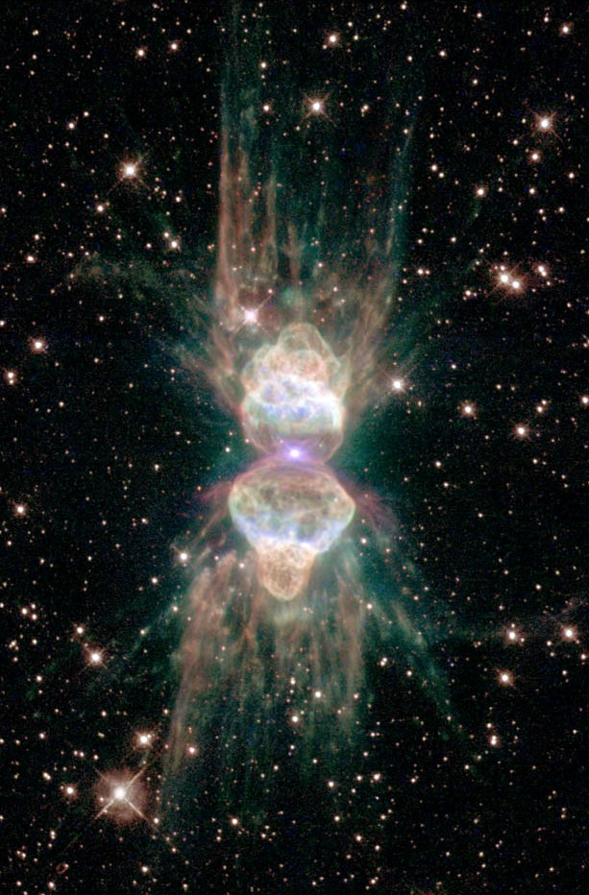
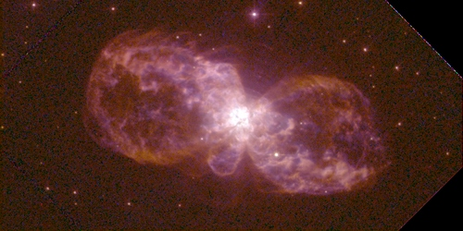
All bipolar PNe have a torus?
Mz3
HST WFPC2
Initial mass > 4M☉ (Pottasch+ 2005)
No dark lanes at the center of Mz3, Hb5.
→ A dust torus? Or not?
Hb5
HST WFPC2
Notes:
This is an image of another bipolar PN Mz three taken by HST.
This is a young PN, and its initial mass is over 4 solar mass.
This is almost the same as NGC six three zero two.
*We can’t see dark lanes at the center of Mz 3.
*Is there a massive or light dust torus? Or, not tori?

Slide 6
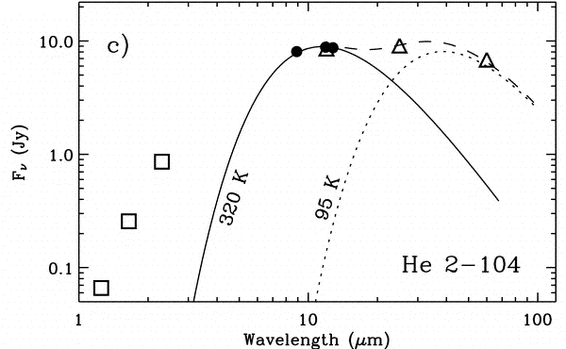
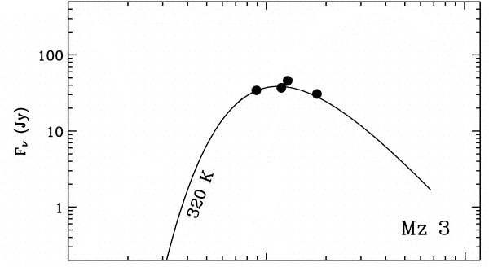
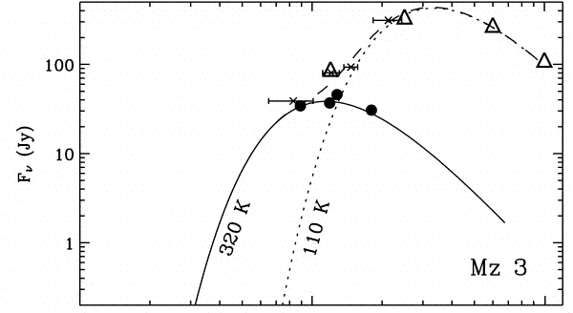
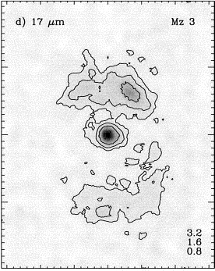
Previous studies of Mz3
Warm component in the central region : M_{dust} = 1.1x10⁻⁶ M☉ (Smith+ 2005, with ESO3.6m)
- A light dust disk in the central region : M_{dust} = 0.9x10⁻⁵ M☉ (Chesneau+ 2007, with MIDI)
Cold components in the lobes : M_{dust} = 2.6x10⁻³ M☉ (Smith+ 2005, with IRAS)
→ IRAS can’t resolve the central disk (torus) and the lobes.
Smith+ 2005
Total
Is the dust
disk light?
？
Central star
Light dust disk
1.0x10⁻⁵ M☉
IRAS beam size
Notes:
There are a lot of previous studies about the dust in Mz three.
A right figure is the mid-infrared image at seventeen micron obtained by an ESO three point six meters telescope reported by Smith et al two thousand five.
The central region is clearly resolved in these images.
*They measured the fluxes at central region. These are plotted ina left figure. They estimated the mass of the central region to be one point one times ten to the minus sixth power.
Recently Chesneau et al. twenty zero seven observed the central region by the mid-infrared interferometer MIDI, and found a geometrical thin warm dust disk at the central region.
They claimed mass of this dust disk is one times ten to minus fifth power solar mass.
**These show the fluxes at longer wavelengths measured by the IRAS.
This indicates that Mz three has cold component in addition to the warm dust disk.
* Smith et al suggested that the cold component is in the lobes. Its mass is two point six times ten to minus third power solar mass.
From these result, * a structure of Mz three seem to be as shown in this figure.
*Mz three has the light dust disk at the central star, and the massive cold lobes.
*But IRAS can’t resolve the central disk and the lobes at long wavelength because the beam size of IRAS is very large, about twenty five arcsec at twenty four micron.
The mid-infrared interferometer MIDI can’t detect the cold component because wavelength coverage of the MIDI is from eight to thirteen micron.
In these wavelengths, it is hard to observe the cold component.
Therefore it is not clear that the central region does not have a cold component or not.
*Is the dust disk actually light?
To answer this question, spatially resolved observations at the longer wavelength are needed.
**Thus, we carried out mid-infrared observation Mz three at these wavelengths.

Slide 7
Observations
Mz3
HST WFPC2
Object : bipolar PN Mz3, Hb5
Instrument : miniTAO / MAX38
Wavelength : 18.7, 25, 31.7 um
OBJ Name | Wavelength [um] | date | Intergration Time [s]
Mz3 | 18.7 | 2011.5.28 | 400
Mz3 | 25.0 | 2012.10.21 | 1000
Mz3 | 31.7 | 2011.5.28 | 3000
Hb5 | 18.7 | 2012.10.20 | 500
Hb5 | 25.0 | 2012.10.20 | 900
Hb5 | 31.7 | 2012.10.24 | 3000
Hb5
HST WFPC2
Notes:
We observed Mz three with miniTAO / MAX thirty eight.
We use two bands, one is eighteen point seven micron, the others is thirty one micron.
Integral time is four hundreds seconds at eighteen point seven micron, and three thousands seconds at thirty one micron.

Slide 8
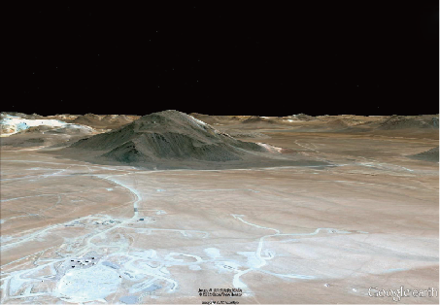
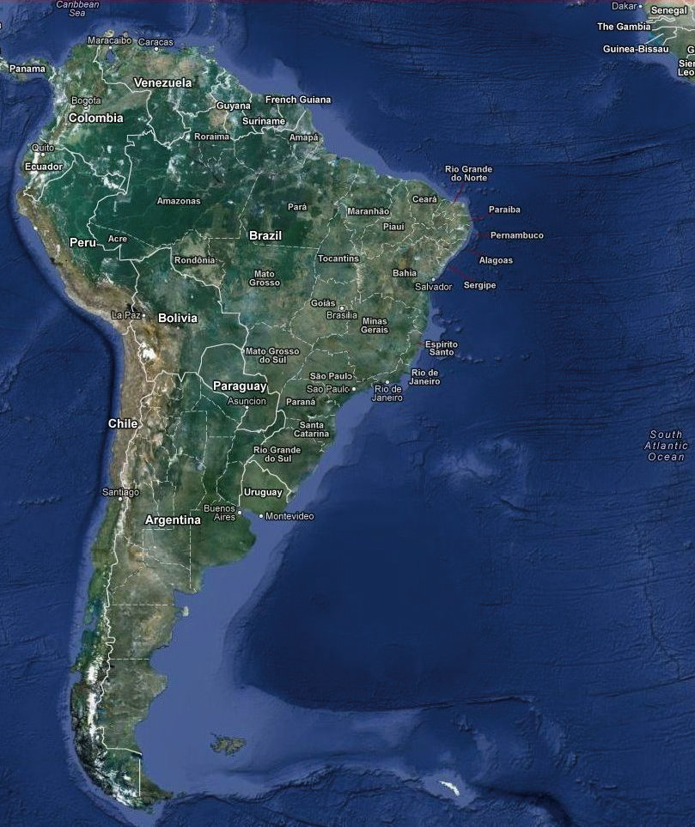
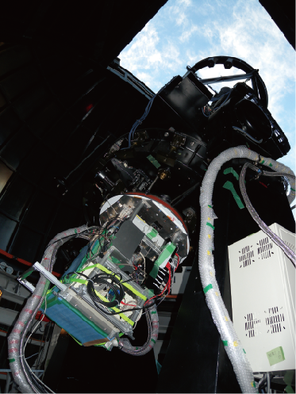
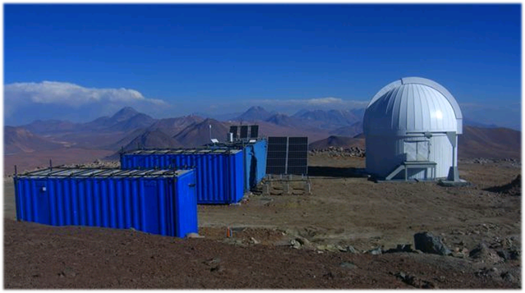
miniTAO / MAX38
miniTAO
- 1.0m telescope
- Atacama desert in northern Chile
- The summit of Cerro Chajnantor (5,640m)
→ The best site for infrared astronomy
MAX38
- Our own developed mid-infrared camera
- The unique instrument which has an imaging
capability at 30 micron bands from the ground
- Wavelength coverage : 8 – 38 um
- Spatial resolution : 8” at 30 um
Co.Chajnantor (5,640m)
Atacama,
Chile
miniTAO
miniTAO/MAX38
Notes:
MiniTAO is the one point zero meter telescope.
And it is at the summit of cerro chajnantor in northern chile.
Its altitude is five thousands and six hundreds fourty meters.
It is extremely high!
Thanks to the high altitude and dry weather conditions, this site is the best site for infrared astronomy, especially for the mid-infrared.
*And, we used an instrument MAX thirty eight.
*This is a photo of the MAX thirty eight.
MAX thirty eight is our own developed mid-infrared camera for miniTAO telescope.
It is only the instrument which has an imaging capability at thirty micron-bands from the ground.
Its wavelength coverage is from eight to thirty eight micron.
And spatial resolution is about five arcsec at eighteen micron and eight arcsec at thirty micron.
It is slightly higher than the previous satellite telescopes.

Slide 9
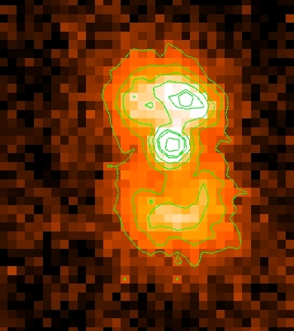
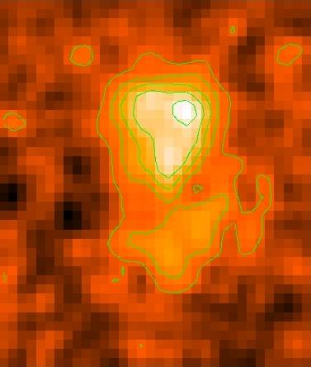
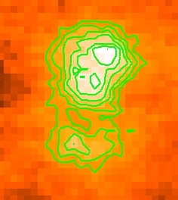
Results Mz3
Spatially resolved images of Mz3 at 18 and 31 um were obtained.
A bright peak is seen at the center of the 18-um image.
The 18-um image well resembles the 17-um image obtained by Smith (2005).
The central region is also bright in the 31-um image.
18.7 um
31.7 um
25 um
17.0 um
20”
20”
20”
Smith+ 2005
contour : 3σ
contour : 3σ
contour : 3σ
Notes:
We obtained spatially resolved images of Mz three at eighteen and thirty one micron.
The image at eighteen micron with MAX thirty eight is shown in the upper panel, thirty one micron is the bottom.
Contours are drawn at three sigma level above the background.
A bright peak is seen at the center of the eighteen micron image.
*And the eighteen micron image is quite similar to the seventeen micron image obtained by Smith et al.
**In the thirty one micron image the central region is also bright.
This is a very important point of our results.

Slide 10
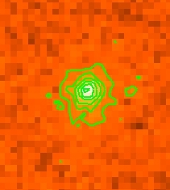
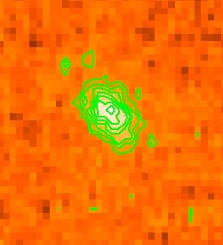
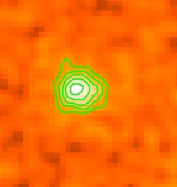
Results Hb5
Spatially resolved images of Hb5 at 18 and 25 um were obtained. A image at 31um was not resolved.
A bright peak is seen at the center of the
18, 31-um image.
The 25um image contains [NII].
10”
18.7 um
25 um
31.7 um
10”
10”
10”
contour : 3σ
contour : 1σ
contour : 3σ
STD:10σ
STD:10σ
STD:5σ
Notes:
We obtained spatially resolved images of Mz three at eighteen and thirty one micron.
The image at eighteen micron with MAX thirty eight is shown in the upper panel, thirty one micron is the bottom.
Contours are drawn at three sigma level above the background.
A bright peak is seen at the center of the eighteen micron image.
*And the eighteen micron image is quite similar to the seventeen micron image obtained by Smith et al.
**In the thirty one micron image the central region is also bright.
This is a very important point of our results.

Slide 11
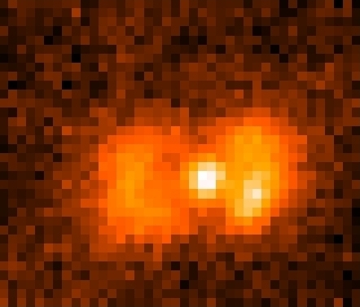
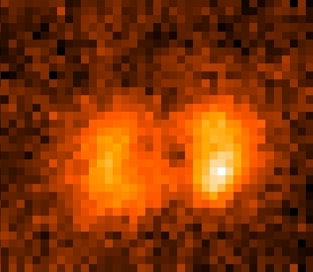
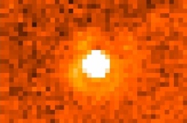
Analysis : photometry
・ PSF photometry : the fluxes of the central region at 18/31 um
・ The 31um flux of the central region is much larger than the expected value.
Object (Mz3)
PSF
-
=
Wavelength [um] | Flux [Jy] | Instrument
8.9 | 34.3 | ESO3.6/TIMMI2
11.9 | 36.9 | ESO3.6/TIMMI2
17.0 | 30 | ESO3.6/TIMMI2
18.7 | 55±7 | miniTAO/MAX38
31.7 | 157±40 | miniTAO/MAX38
MAX38
157±40
55±7
Notes:
We measured the flux of the bright central region.
The central core of Mz three seems to be a point source in our images.
So, we apply a PSF photometry to the eighteen and the thirty one micron images.
The PSF was estimated from images of stars, and subtract it from the image of Mz three.
This figure shows the measured fluxes of eighteen and thirty one micron.
The errors of this photometry are estimated from the deviation of the blank sky count.
The eighteen micron flux at the central star gives a good agreement with Smith et al.
*However, the thirty one micron flux at the central star is much larger than the expected value.
This clearly indicates that an additional cold component exist in the central region.

Slide 12
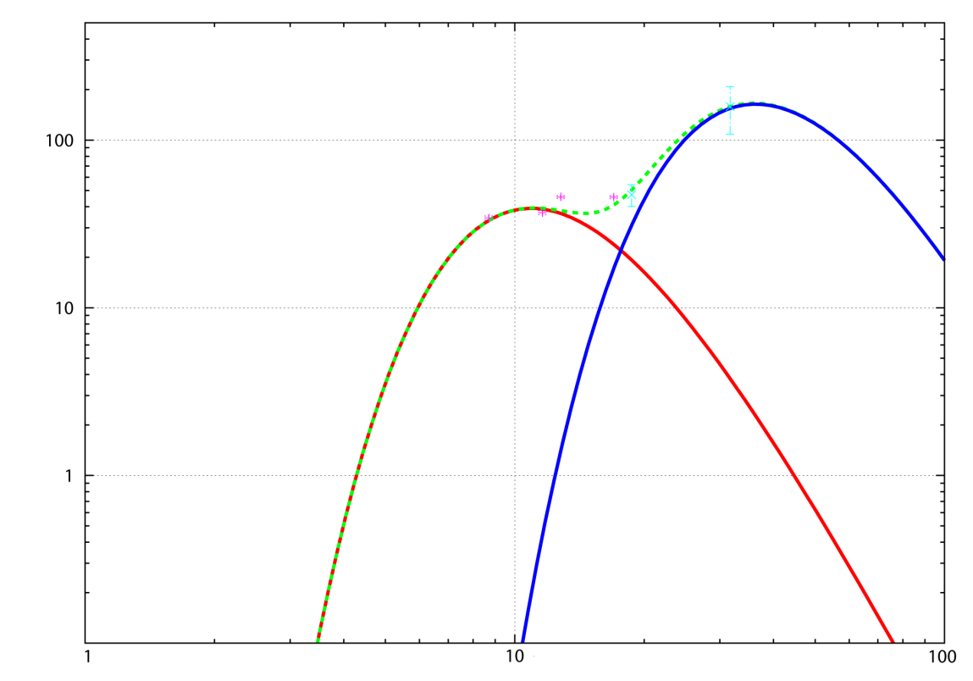
Analysis : mass estimation
Masses of the warm/cold component at the center are estimated by a graybody fitting with λ⁻¹ emissivity.
- We apply the equation of Smith (2005) to this results.
→ Massive dust torus in Mz3
$$M_{dust}=\left(\frac{aρ}{3σQ_{e}{\left(T_{dust}\right)}^{4}}\right)L_{dust}$$
Graybody fitting results
Central region |  | Smith+2005 | This work
warm component | Dust mass [M☉] | 1.1x10⁻⁶ | 0.8x10⁻⁶
 | Temperature [K] | 320 | 220
cold component | Dust mass [M☉] | - | 3.0x10⁻³
 | Temperature [K] | - | 70
Smith+ 2005
 | parameter | value
a | Grain size | 0.05-1.0 [um]
ρ | Density | 2.25 [g/cm³]
σ | Stefan-Boltzman | 5.7e-8 [W/m²/K⁴]
Q_{e} | Emissivity | Gilman+ 1974
T_{dust} | Temperature | 70 [K]
L_{dust} | Luminosity | 540 [L☉]
This work
flux [Jy]
220K
70K
wavelength [um]
Notes:
We estimate the temperature and the mass of the central region in Mz three.
Temperatures of the warm and the cold component at the central region are estimated by graybody fittings with lambda to negative first power emissivity.
This figure is the results of Smith et al twenty zero five.
The fitted SEDs with Smith et al and our results are shown in next figure.
*The cold component is well fitted by the temperature of seventy kelvin, and the warm component is fitted by two hundreds thirty kelvin.
To estimate these masses, we apply the equation of Smith et al. twenty zero five to these results.
This equation is shown here.
In this calculation, we adopt values in this table.
Tdust and Ldust are come from our fittings.
The other values are same in Smith twenty zero five.
This is the same method as adopted by Smith et al. twenty five.
*This table shows in our result of fitting.
The mass of cold component in the central region is one point zero times ten to minus third power solar mass.
**Mz three has the cold massive component in the central region.

Slide 13
Massive dust torus in Mz3
Light dust disk
1.0x10⁻⁵ M☉
massive dust torus
3.0x10⁻³ M☉
Previous
This work
Notes:
These results indicate there is also massive cold component in the central region.
Its dust torus mass is lighter than NGC six three zero two.
But it is amazing that Mz three has a massive torus at the central region.

Slide 14
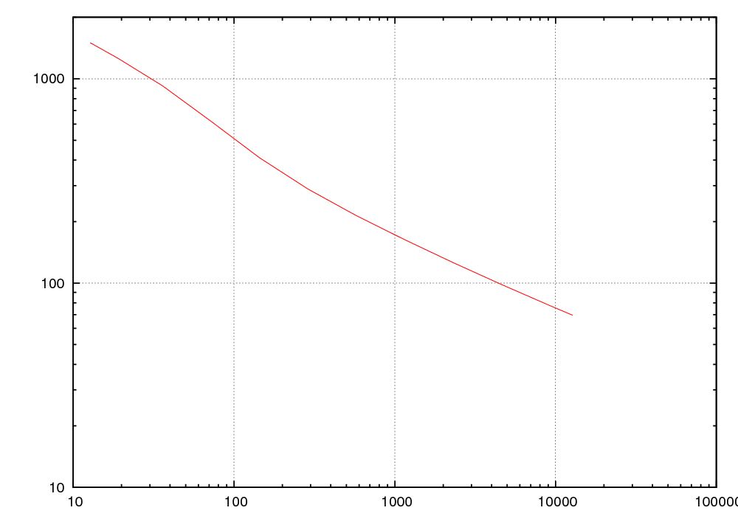
Discussion : cold torus
Observation … MAX38 couldn’t resolve the cold torus with 31um
- MAX38 31um resolution : 8 arcsec ~ 10000 AU
→ cold torus < 5000 AU
Thermal equilibrium : the cold torus distance from the central star ~ 11000 AU
- optically thin
- normal size dust
not resolved
resolved
parameter | Value
Dust | Astronomical silicate (Draine & Lee 1948)
Grain shape | Spherical
Grain size | 0.005-0.25 [um]
Size distribution | a^{-3.5}
Dust temperature | 70 [K]
Luminosity of star | 10000 [L☉]
dust temperature [K]
70K
distance [AU]
Notes:
As mentioned above, the cold massive torus of Mz three was a point source at thirty one micron.
The spatial resolution of MAX thirty eight at thirty one micron is eight arcsec.
It is correspond to ten thousand AU at the distance of Mz3.
Thus the radius of the massive torus should be less than five thousands AU.
We calculate the relation between a distance of dust grain from central star and dust temperature with a thermal equilibrium.
Assumptions of this calculation are in the left.
This figure is the result of the calculation; it is the relation of dust temperature and the distance from the central star.
This shows that a seventy kelvin dust component is at about fifteen thousand AU from central star.
*If these assumptions are correct, MAX thirty eight can resolve this structure.
But practically, we couldn’t resolve the cold massive torus.
This is a discrepancy.

Slide 15
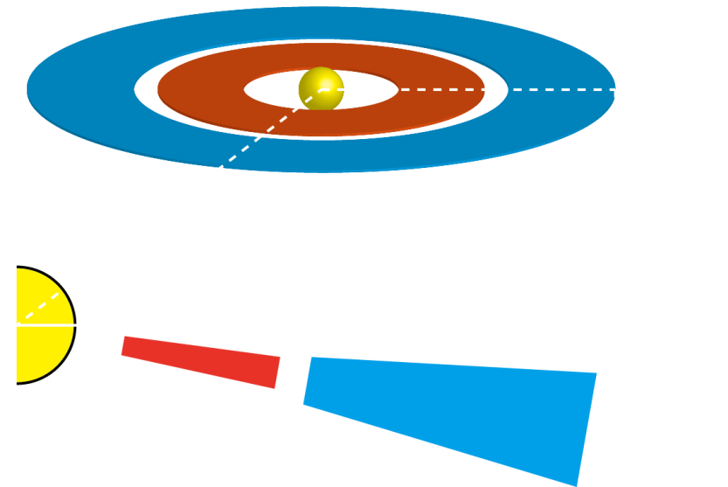
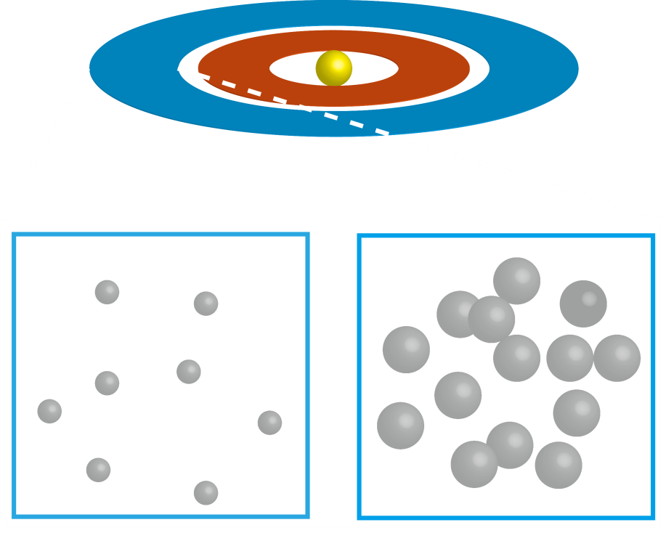
possible explanations
1) Extinction of stellar radiation
by the inner disk
2) Growth of dust grains
in the torus
Chesneau+ 2007
tau_{N} ~ 3.5
Notes:
To resolve this discrepancy, two possibilities are examined.
The first is the extinction of the stellar radiation by the inner disk.
If the stellar radiation extinct before it reaches to the massive outer torus, the dust temperature decreases. Therefore the size becomes small.
According to Chesneau et al. two thousand zero seven model, the optical thickness of the inner disk is three point five at the N-band. It seems enough.
If this is the case, the massive torus is geometrically thin, and it locates in the same plane of the inner disk. It may give a strong constraint to the formation of the massive torus.
The other possibility is the growth of the dust in the massive torus.
If the dust grains are larger than our assumptions, the temperature of the dust also decreases and the size of the torus become small.
The density of the massive torus is expected to be very high, it may be possible the dust grains grow in the massive cold torus. We will carry out further quantitative modeling of them.

Slide 16
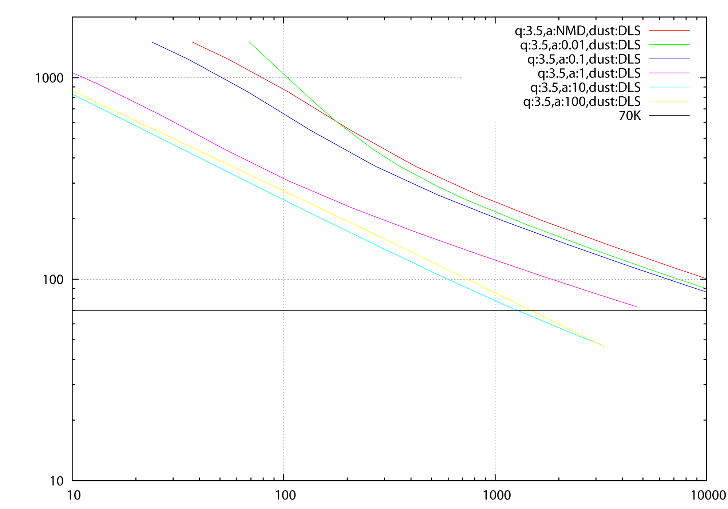
2) Growth of dust grains in the Mz3 torus ?
not resolved
resolved
Temp[K]
parameter | Value
Dust | Astronomical silicate
Grain shape | Spherical
Grain size | 0.01-100 [um]
Size distribution | a^{-3.5}
Dust temperature | 70 [K]
Luminosity of star | 10000 [L☉]
Effective temp | 35000 [K]
70K
radius [AU]

Slide 17
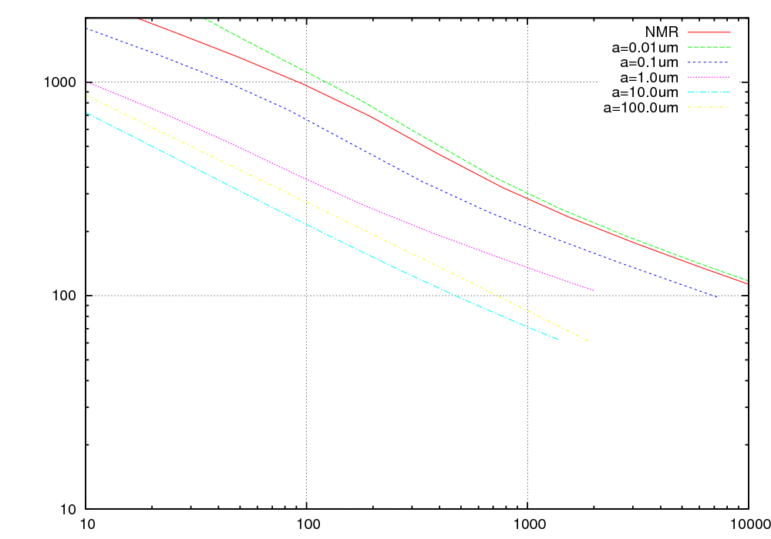
2) Growth of dust grains in the Hb5 torus ?
not resolved
resolved
Temp[K]
parameter | Value
Dust | Astronomical silicate
Grain shape | Spherical
Grain size | 0.01-100 [um]
Size distribution | a^{-3.5}
Dust temperature | 70 [K]
Luminosity of star | 7000 [L☉]
Effective temp | 170000 [K]
70K
radius [AU]

Slide 18
Summary
We successfully obtained spatially resolved images of Mz3 at the 18.7 and the 31.7um bands. (Unresolved Hb5).
The cold component of T~70K was found at the central region.
The mass of the torus (1.0x10⁻³ M☉) is 100 times higher than the previous studies.
Assumptions of the dust grain growth or the existence of optically thick inner disk can explain the unresolved Mz3 dust torus with MAX38 / thirty micron.
Notes:
This is the summary of our study.
We successfully obtained spatially resolved images of Mz three at the eighteen point seven and the thirty one point seven micron bands.
The cold component of temperature seventy kelvin was found at the central region.
The mass of the torus (disk) is one point zero times ten to minus third power solar mass, it is one hundred times higher than the previous studies.
Assumptions of the dust grain growth or the existence of optically thick inner disk can explain the unresolved dust torus with MAX thirty eight / thirty micron. *

Slide 19
end
Notes:
Thank you.

Slide 20
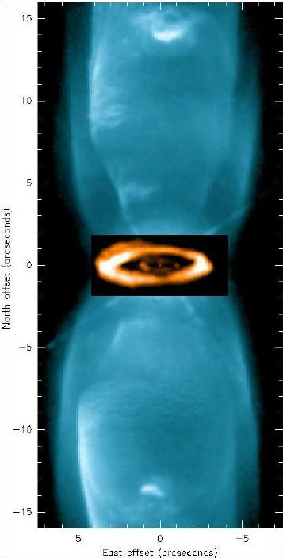
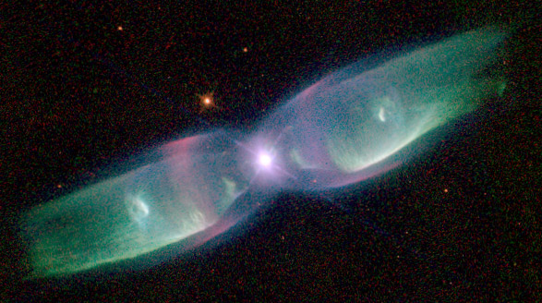
Similar torus in bipolar PN:M2-9
Bipolar PN : M 2-9
- Similar structure to Mz3
- initial mass > 2M☉ (Palla+ 1999)
- No dark lanes at the center region
- A light disk in the central region : M_{dust} = 1.5x10⁻⁵M☉
(Lykou+ 2011, with MIDI)
Double ¹²CO 2-1 ring were detected (Castro2012)
Outer ring : M_{gas}=1.0x10⁻² M☉
Castro+ 2012
Notes:
Very recently, a similar massive torus was detected in another bipolar PN M2-9.
This image is a bipolar nebula M two-nine obtained by HST.
M2-9 is thought to be similar to Mz3.
The structure of the nebula is very similar, its initial mass is over two solar mass, and *it shows no dark lane at the center. *Recent MIDI observations found a light disk of one point five times ten to minus fifth power solar mass.
Castro et al twenty twelve carried out CO observations with high spatial resolution, and reported the new structure at the central region in bipolar nebula.
*It is double rings. They are expanding rings, and they were formed by intermittent mass loss within five hundred years.
A cold component in Mz three may be analogous with this outer ring in M two-nine.

Slide 21
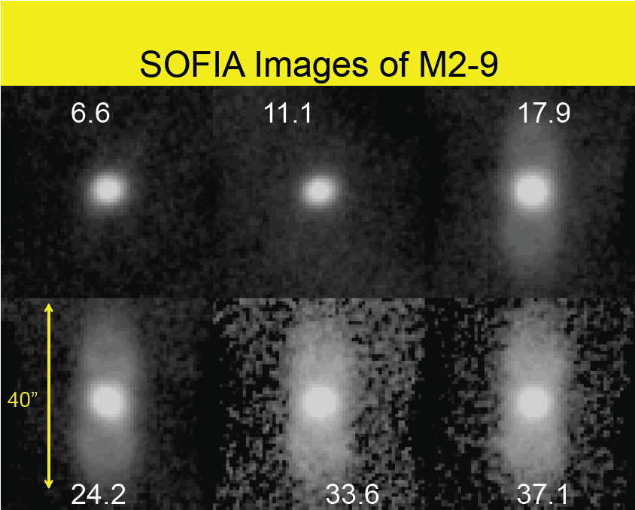

Slide 22
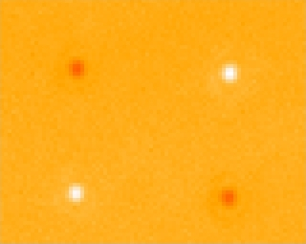
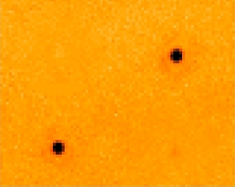
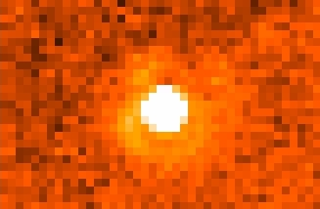
psf photometry 18um
ratio
0.29-0.44

Slide 23
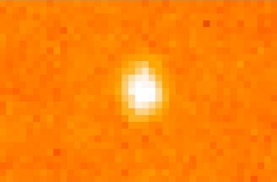
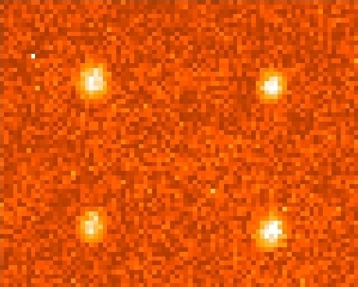
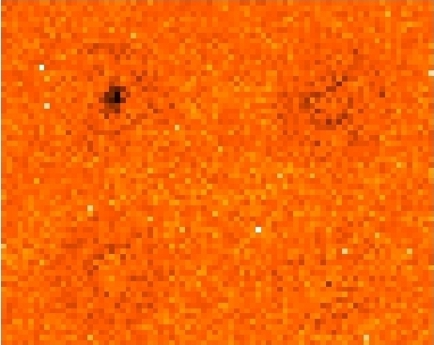
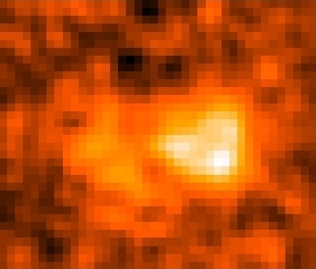
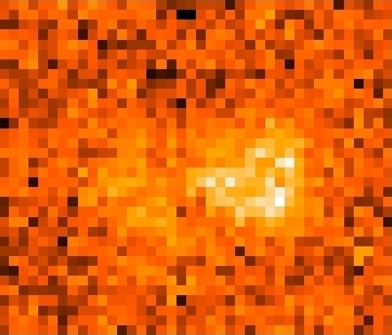
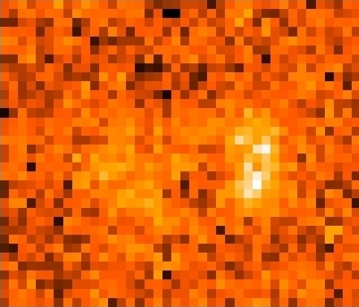
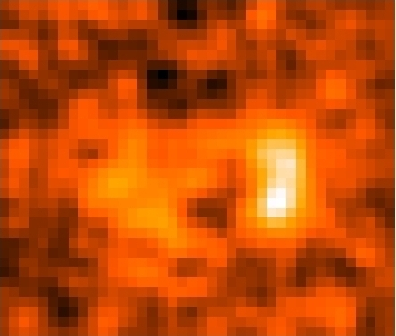
psf photometry 31um
ratio
0.15-0.21

Slide 24
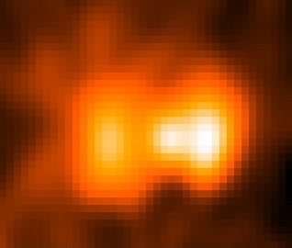
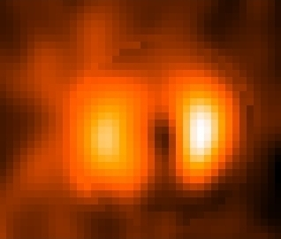
How to distinguish the contamination
18um image convoled
with 31um psf
18um image
31um
psf
Psf photometry

Slide 25
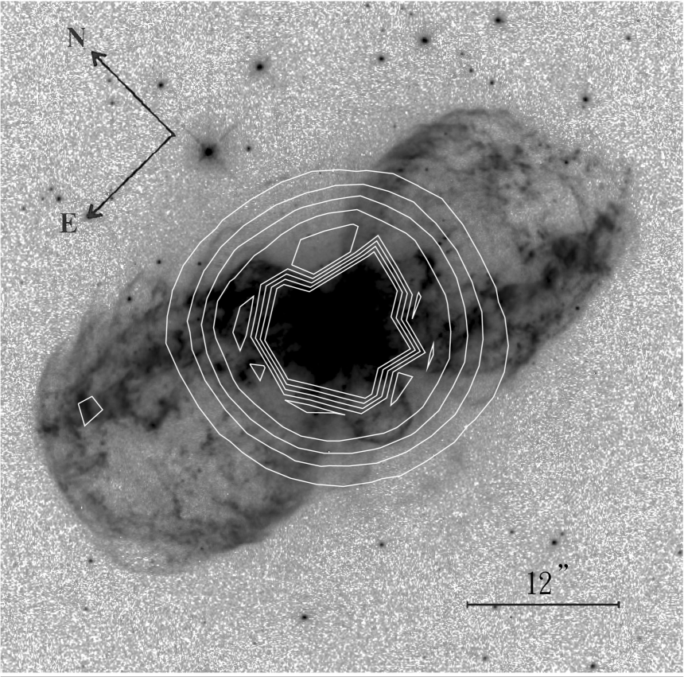
MIPS 24um

Slide 26
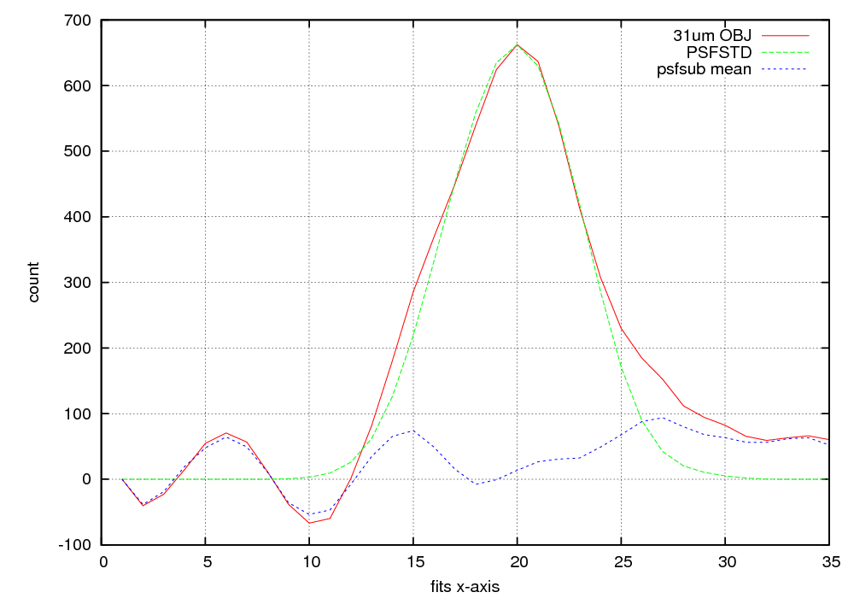

Slide 27
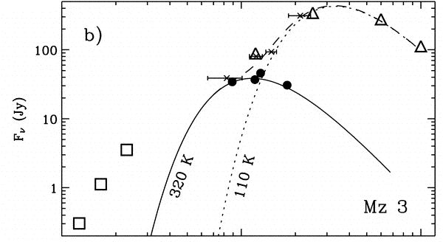

Slide 28
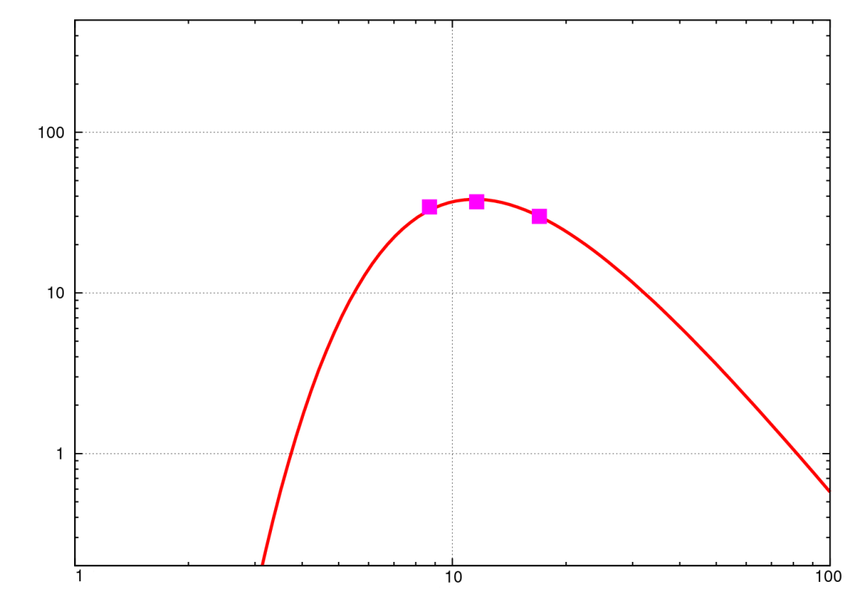
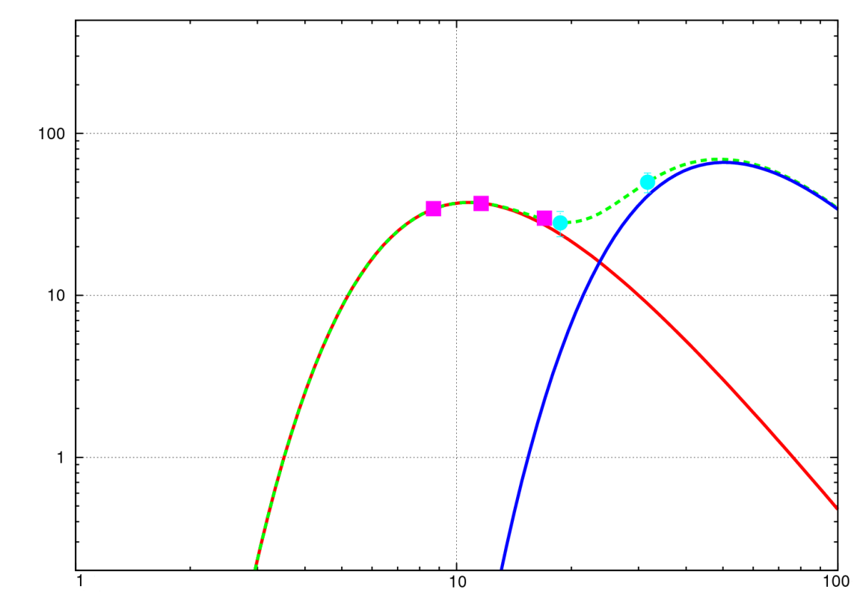
Analysis : mass estimation
Masses of the warm/cold component at the center are estimated by a graybody fitting with λ⁻¹ emissivity.
- We apply the equation of Smith (2005) to this results.
→ Massive dust torus in Mz3
$$M_{dust}=\left(\frac{aρ}{3σQ_{e}{\left(T_{dust}\right)}^{4}}\right)L_{dust}$$
Graybody fitting results
Smith+ 2005
Central region |  | Smith+2005 | This work
warm component | Dust mass [M☉] | 1.1x10⁻⁶ | 0.8x10⁻⁶
 | Temperature [K] | 320 | 340
cold component | Dust mass [M☉] | - | 1.0x10⁻³
 | Temperature [K] | - | 70
This work
 | prameter | value
a | Grain size | 0.05-1.0 [um]
ρ | Density | 2.25 [g/cm³]
σ | Stefan-Boltzman | 5.7e-8 [W/m²/K⁴]
Q_{e} | Emissivity | Gilman+ 1974
T_{dust} | Temperature | 70 [K]
L_{dust} | Luminosity | 180 [L☉]
flux [Jy]
320K
340K
70K
wavelength [um]
Notes:
We estimate the temperature and the mass of the central region in Mz three.
Temperatures of the warm and the cold component at the central region are estimated by graybody fittings with lambda to negative first power emissivity.
This figure is the results of Smith et al twenty zero five.
The fitted SEDs with Smith et al and our results are shown in next figure.
*The cold component is well fitted by the temperature of seventy kelvin, and the warm component is fitted by two hundreds thirty kelvin.
To estimate these masses, we apply the equation of Smith et al. twenty zero five to these results.
This equation is shown here.
In this calculation, we adopt values in this table.
Tdust and Ldust are come from our fittings.
The other values are same in Smith twenty zero five.
This is the same method as adopted by Smith et al. twenty five.
*This table shows in our result of fitting.
The mass of cold component in the central region is one point zero times ten to minus third power solar mass.
**Mz three has the cold massive component in the central region.

