Slide 1
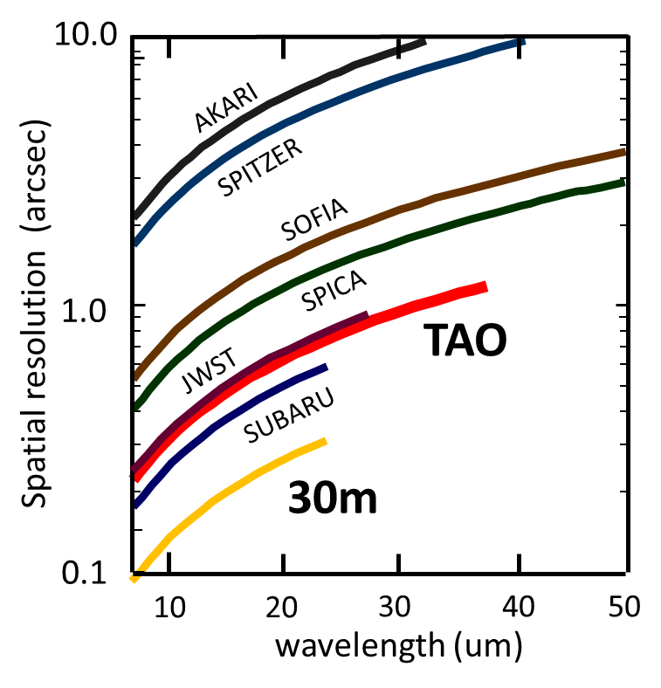
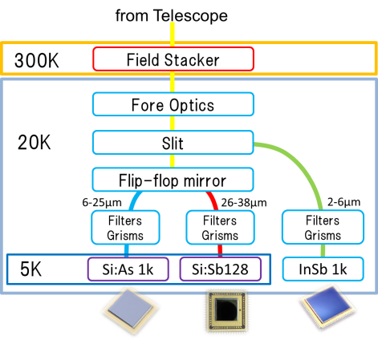
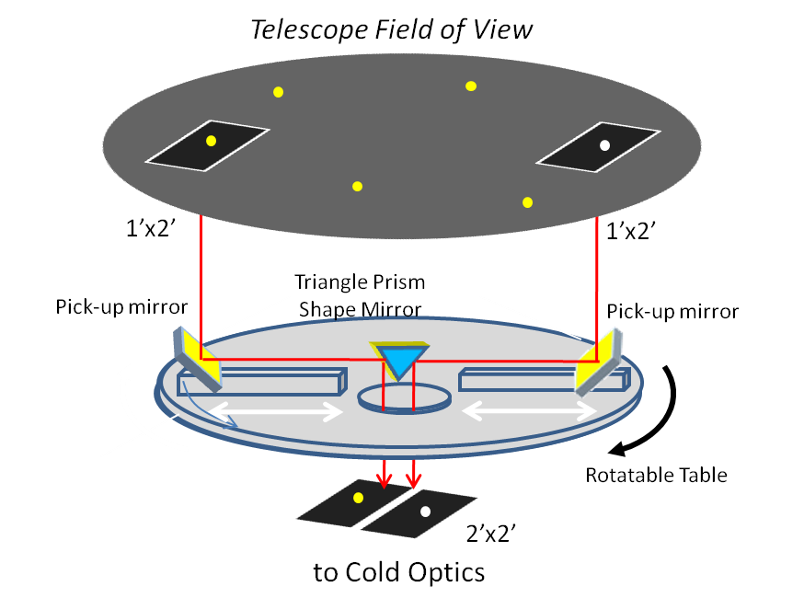
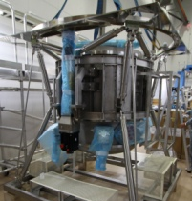
MIMIZUKU Fact Sheet
MIMIZUKU (Mid-Infrared Multifield Imager for gaZing at the UnKown Universe) is a mid-infrared imager and spectrograph for the University of Tokyo Atacama Observatory (TAO; P.I.: Yuzuru Yoshii) 6.5-m telescope.
Key concepts of the MIMIZUKU are:
Wide wavelength coverage (2-38μm) including 30μm wavelength range.
High spatial resolution acheiving <1” resolution in mid-infrared wavelengths
Accurate monitoring with multi-filed imaging/spectroscopy
Specifications of MIMIZUKU
Observation Mode | Imaging and spectroscopy
Dimensions, weight | 2.0 x 2.0 x 2.0 m³ , 2.3 tons
Channel / Wavelength coverage | NIRchannel : 2-6 μm MIR-S channel: 6-26μm MIR-L channel: 26-38μm
Detector | InSb 1k / Si:As 1k / Si:Sb 128 (or 1k)
Field of View | 2’x2’ (normal mode) 1’x2’ x2fields (w/ Field Stacker)
Spatial Resolution | 0.3” @10um / 1.0” @30um (see right)
Spectral Resolution | R ~ 250 (N-band/Q-band/30um-band)
1sig1sec Sensitivity Imaging (R~10) Spectroscopy (R~250) | 30mJy@10um/ 130mJy@20um/ 0.5Jy @30um 150mJy@10um/ 0.6Jy @20um / 1.5Jy @ 30um
Spatial resolution of mid-infrared instruments. TAO/MIMIZUKU achieves the highest spatial resolution at 26-38μm.
MMIZUKU employs three detectors. For the short side of the mid-infrared wavelengths (6-26micron) a state-of-the-art Si:As BIB detector (called AQUARIOUS) will be used. It has a 1k array format with a pixel size of 30 micron. For the longer mid-infrared (26-38micron), we will use a Si:Sb 128x128 or a 1k array detector. The InSb array Aladdin II is used for the near-infrared observations.
Optics of the MIMIZUKU consist of four components, fore-optics, NIR-channel, MIR-S-channel, and MIR-L-channel. All optical components are cooled to 20 K. To achieve the wide wavelength coverage from 2 to 38 micron, reflective optics is adopted.
Diagram of the MIMIZUKU optics
The field stacker is a newly invented optical unit to achieve accurate photometry in the mid-infrared wavelengths. It consists of two pick-up mirrors and a triangular-prism shape mirror on a rotatable table. The pick-up mirrors can move along the radial direction of the rotatable table, and pick up two separate fields in the telescope field of view. The picked-up beams are brought to the triangular-prism shape mirror, combined into the single beam, and then led to the cold optics.
Thus the field stacker enables us to observe two arbitrary fields of view, i.e. two or more stars simultaneously. It will dramatically improve the accuracy and the feasibility of photometric observations.
Schematic drawing of the field stacker
For further information:
contact to Dr. Takashi Miyata (P.I. : tmiyata@ioa.s.u-tokyo.ac.jp)
or visit the project website http://www.ioa.s.u-tokyo.ac.jp/TAO/MIMIZUKU/

